Slide 1
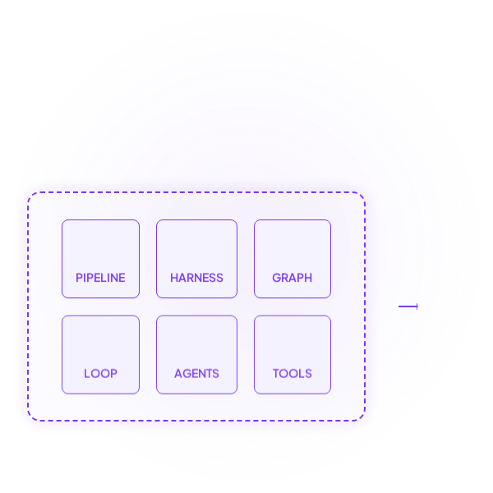



VISION
We don't just build AI agents.
We engineer how AI builds software.
AI ENGINEERING FACTORY

Slide 2












From AI Assistance to AI Engineering
TODAY: FRAGMENTED ASSISTANCE
FUTURE: ENGINEERED SYSTEM
TRANSFORMATION

Slide 3




The New Engineering Operating Model
COMPOSE
GOVERN
EXECUTE
RECOVER
ENGINEER
ACT
PROVE
REMEMBER

Slide 4





















Inside the AI Engineering Factory
CONTROL PLANE
EXECUTION PLANE
DATA LAYER
REAL ENGINEERING SYSTEMS

Slide 5








Harness is the Governance Backbone
"NOTHING EXECUTES OUTSIDE THE HARNESS RUNTIME."
HARNESSED EXECUTION BOUNDARY
TIMEOUT: 300S
COST LIMIT: $5.00
HUMAN APPROVAL: AUTO

Slide 6










Graph Defines the Engineering Path
"EXECUTION TOPOLOGY"
PASS
FAIL
QUALITY GATE

Slide 7








When Engineering Fails — The System Recovers
LOOP LIMITS
Max Iterations: 3
Cost Cap: $2.50

Slide 8

From One-Off Prompts to Reusable Workers
AGENT CONTRACT
Role: Refactor
Model: GPT-4o
Skills: Java, API
Tools: Git, AST
Perms: src/payment
Limits: Cost, Time

Slide 9

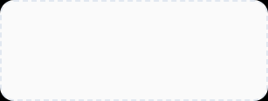
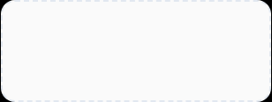

The Engineering Capability Layer
SKILLS
TOOLS
MODELS
React Java Python JUnit Security
Git Jira Terminal Build Sonar
Provider Routing Cost Cap Latency Fallback

Slide 10


Greenfield: Requirement to Running Application
REQUIREMENT
ARTIFACT
STORIES
CODE
SONAR
DEPLOY
NEW GENERATION ARTIFACT
Architecture Map
Domain Model
API Specs
Story Map

Slide 11




Every Story is an Engineering Contract
JIRA-101
TEST CONTRACT
User Registration
TC-001: Valid registration
TC-002: Duplicate email
Acceptance Criteria:
- Valid reg succeeds
- Duplicate rejected
TC-003: Invalid format
"TEST BEFORE IMPLEMENTATION."

Slide 12







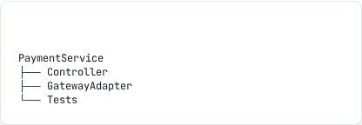
Brownfield: Discover Before Changing
DISCOVERY SCANNER
Architecture APIs Database Dependencies Tests
SEMANTIC MODEL

Slide 13

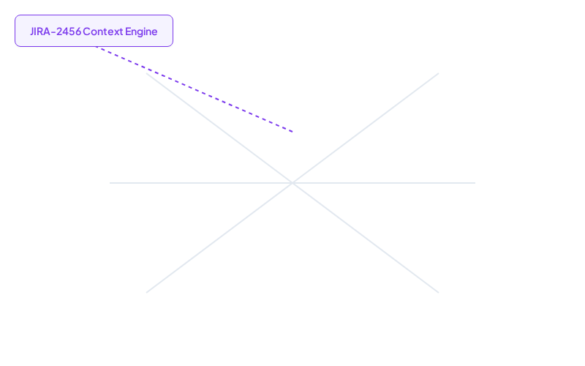







The AI Remembers the Software
"EVERY ACTION UPDATES THE STATE."

Slide 14








Pipelines Compose Governed Capabilities
DEV HARNESS
TEST HARNESS
SEC HARNESS
DEPLOY HARNESS
"PIPELINE = LIFECYCLE COMPOSITION. HARNESS = GOVERNED EXECUTION."

Slide 15



This Is Not A Simulation Layer
AI DECISION SPACE
HARNESS BARRIER
REAL ENGINEERING EXECUTION
$ git checkout -b feature/retry
> Switched to new branch
$ echo "..." > PaymentService.java
$ mvn clean test
> Tests run: 48, Failures: 0
$ git commit -m "Update retry"

Slide 16


Every AI Action Produces Evidence
REQ
AGENT
TOOL
CODE
TEST
IMMUTABLE EVIDENCE LEDGER
Agent ID: coding-gpt4o
Harness: dev-v4
Commit Hash: 9f86d081
Files: PaymentService.java
Tests: 48 / 48 PASSED
SonarQube: PASSED
Risk Score: LOW
Approval: AUTO-APPROVED
"AI OUTPUT WITHOUT EVIDENCE IS AN OPINION. ENGINEERING EVIDENCE MAKES IT ACCOUNTABLE."

Slide 17











Governance Is Embedded Into Execution

Slide 18

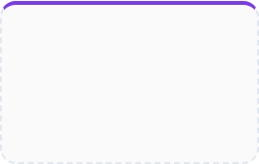
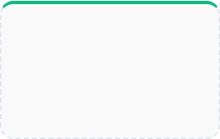
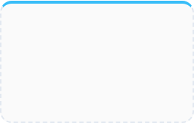
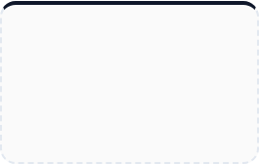
Engineering Intelligence
CYCLE TIME
DEFECT RATE
AI ECONOMICS
HUMAN TOUCH
-60%
-85%
+$0.15
12%
Idea to Production
Pre-deployment bugs
Avg Token Cost per Story
Intervention Rate

Slide 19









Closed Loop Engineering

Slide 20



HARNESSES
PIPELINES
GRAPHS
TOOLS
LOOPS
STATE
AGENTS
EVIDENCE
We don't just build AI agents.
We engineer how AI builds software.

